Slide 1




Employment analysis across the usa Project i
Team Members:
Zoe Liu
Jean- Paul Mitter
Eliana Suarez

Slide 2

Project – Phase 1
Data Source Selection Process
Selection Process Topic
Questions To Answer
Cleaning Data Process

Slide 3

Topic Selection Process
Understanding labor trends to increase job opportunities
Project Objectives
Identify :
Top Cities and States for Employment
Top Types of Jobs for Employment
Best Months to Apply for Jobs

Slide 4

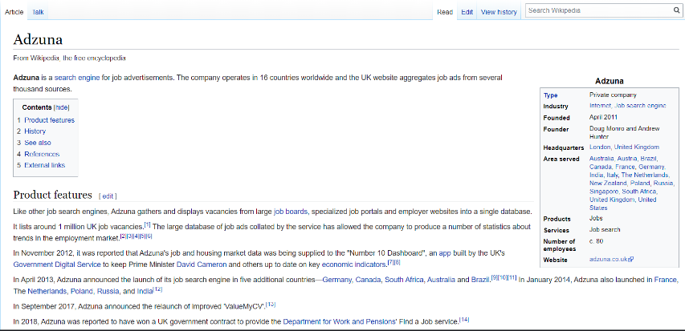

Data Source Selection Process and Challenges
Accessibility Issues
Reliability
Data Set Size

Slide 5
Cleaning Data Process
Reviewing Data for missing information and duplicates
Dropping Empty Rows
Excluding USA Territories
Restructuring Unknown Categories

Slide 6
Project – Phase 2
Visual Aid
Best Months to Apply to Jobs
Top 5 Cities and States for Employment
Jobs Demand Trends in 2019
Top 5 Jobs in Demand

Slide 7
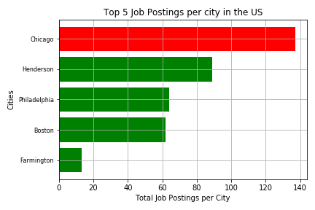
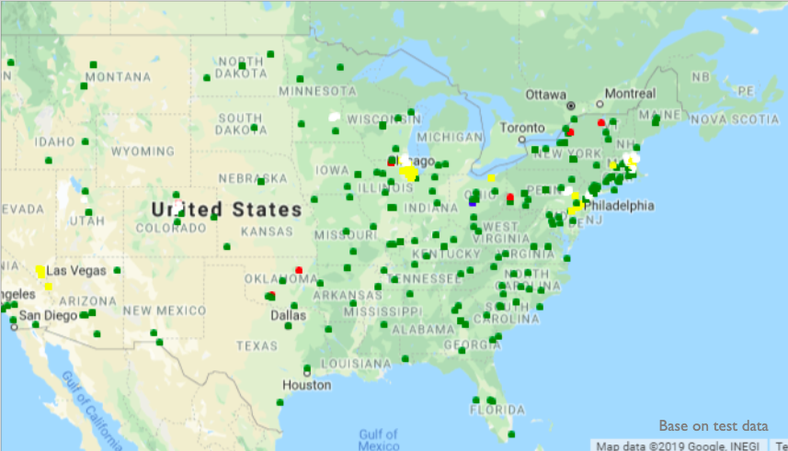
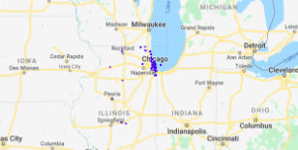
Top 5 Cities and States for Employment

Slide 8
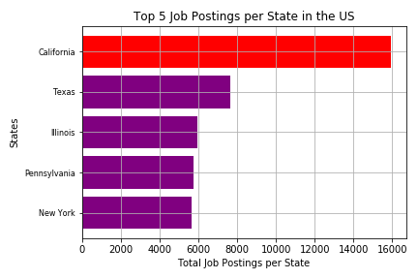
Top 5 Cities and States for Employment

Slide 9
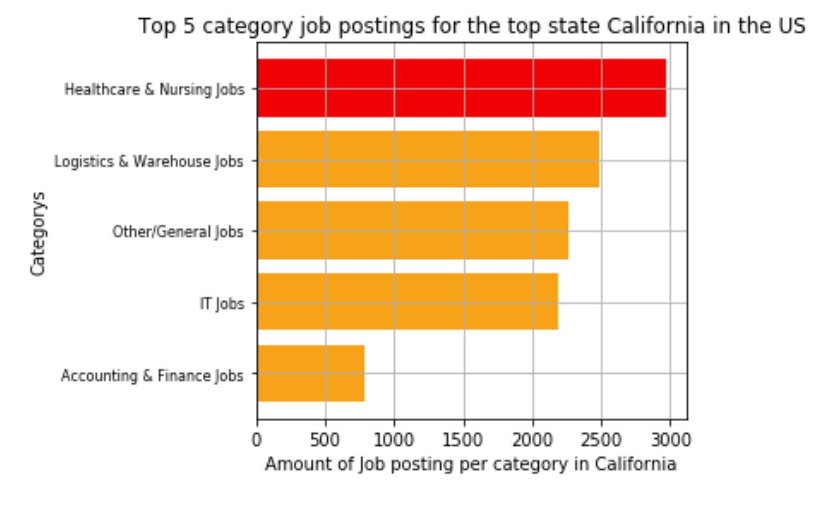
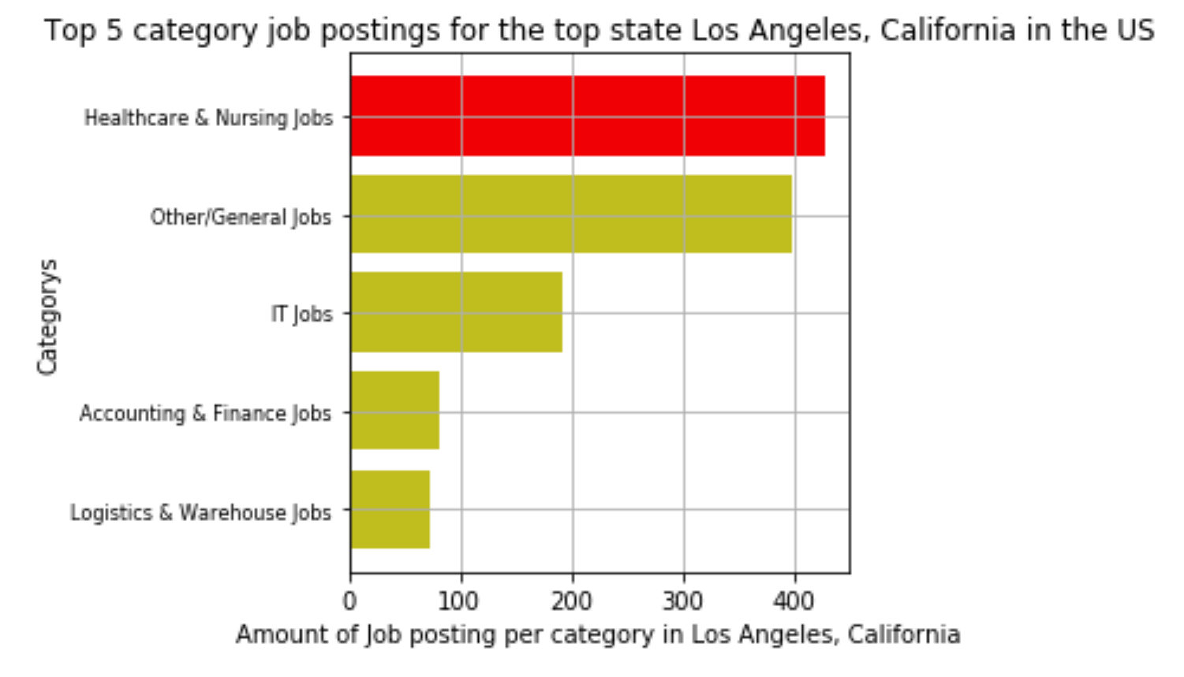
Top 5 Jobs in Demand

Slide 10
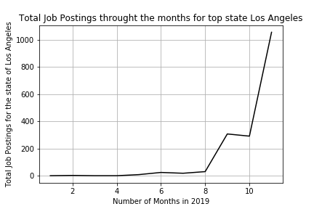
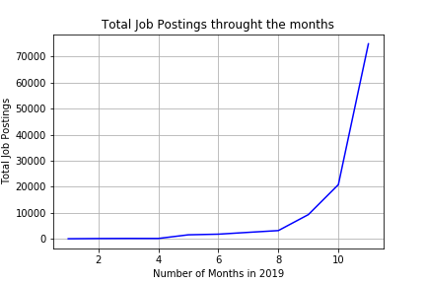
Best Months to Apply to Jobs

Slide 11
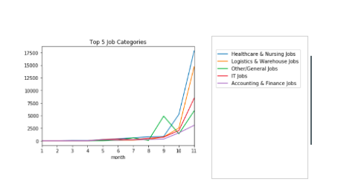
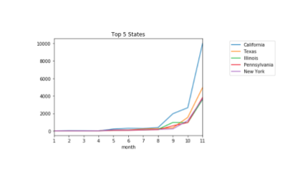
Job Demand Trends in 2019

Slide 12

Opportunities for Improvement
Access to salary and company information
Access to longer history data
Make graphics more interactive
Improve accuracy of data

